Slide 1


Michaela Chronaki 17th February 2024

Slide 2







Outline
Executive Summary
Introduction
Methodology
Results
Conclusion
Appendix

Slide 3
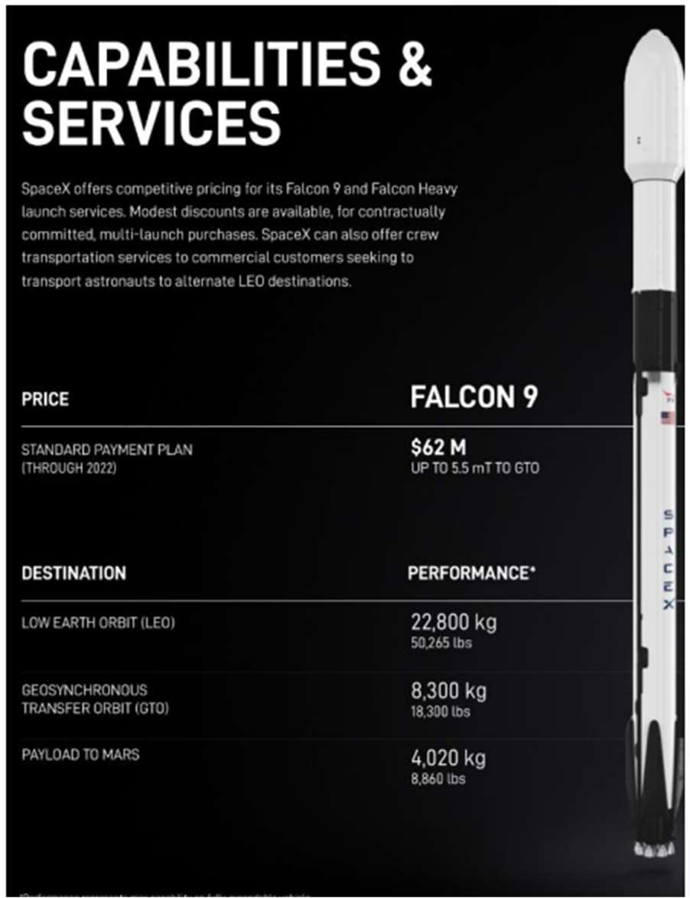
Executive Summary
SpaceY is a new commercial rocket launch provider who wants to bid against SpaceX.
• SpaceX advertises launch services starting at $62 million for missions that allow some fuel to be reserved for landing the 1st stage rocket booster, so that it can be reused.
• SpaceX public statements indicate a 1st stage Falcon 9 booster to cost upwards of $15 million to build without including R&D cost recoupment or profit margin.
• Given mission parameters such as payload mass and desired orbit, the models produced in this report were able to predict the first stage rocket booster landing successfully with an accuracy level of 83.3%.
• As a result, SpaceY will be able to make more informed bids against SpaceX by using 1st stage landing predictions as a proxy for the cost of a launch.

Slide 4


Introduction
Project background and context
Problems you want to find answers
Space X advertises Falcon 9 rocket launches on its website with a cost of 62 million dollars; other providers cost upward of 165 million dollars each, much of the savings is because Space X can reuse the first stage. Therefore, if we can determine if the first stage will land, we can determine the cost of a launch.
This information can be used if an alternate company wants to bid against space X for a rocket launch. This goal of the project is to create a machine learning pipeline to predict if the first stage will land successfully.
What factors determine if the rocket will land successfully?
The interaction amongst various features that determine the success rate of a successful landing.
What operating conditions needs to be in place to ensure a successful landing program.

Slide 5

Section 1
5

Slide 6
Methodology
Executive Summary
Data collection methodology:
Data was collected using SpaceX API and web scraping from Wikipedia.
Perform data wrangling
One-hot encoding was applied to categorical features:
Perform exploratory data analysis (EDA) using visualization
and SQL
Perform interactive visual analytics using
Folium and Plotly
Dash
Perform predictive analysis using
classification models
How to build, tune, evaluate classification models
6

Slide 7
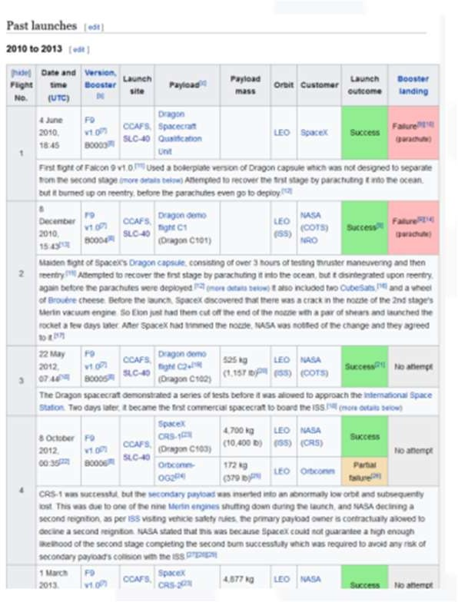
Data Collection
Data Collection
API
Acquired historical launch data from Open-Source REST
API for SpaceX
Requested and parsed the SpaceX
launch data using the GET request
Filtered the dataframe to only include Falcon 9
launches
Replaced missing payload mass values
from classified missions with mean
Web Scraping
Acquired historical
Requested the Falcon9 Launch Wiki
page from its Wikipedia URL
launch data from Wikipedia page 'List of Falcon 9 and Falcon Heavy Launches'
Extracted all column/variable names from the HTML table header
Parsed the table and converted it into a Pandas data frame
What the first page of launch data looked like on Wikipedia prior to web scraping
7
Note: Falcon 9 launch dataset was limited to launches before December 7, 2020 per instructions.

Slide 8
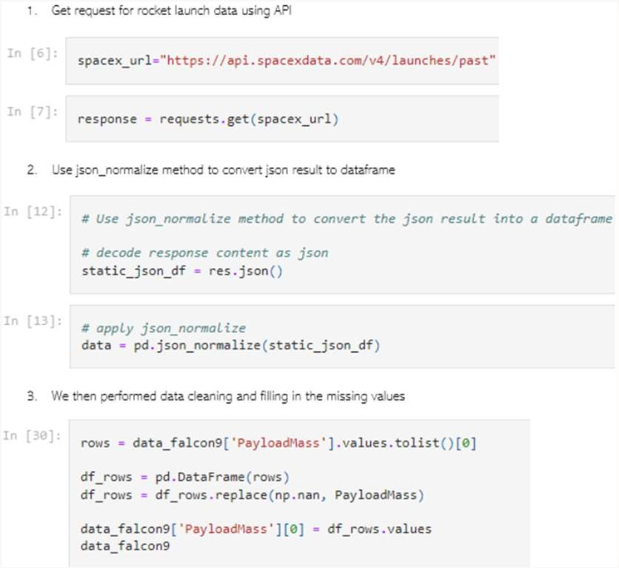
Data Collection – SpaceX API
We used the get request to the
SpaceX API to collect data, clean the requested data and did some basic data wrangling and formatting.
The link to the notebook is
https://github.com/ellachronaki/ibm-projects
8

Slide 9



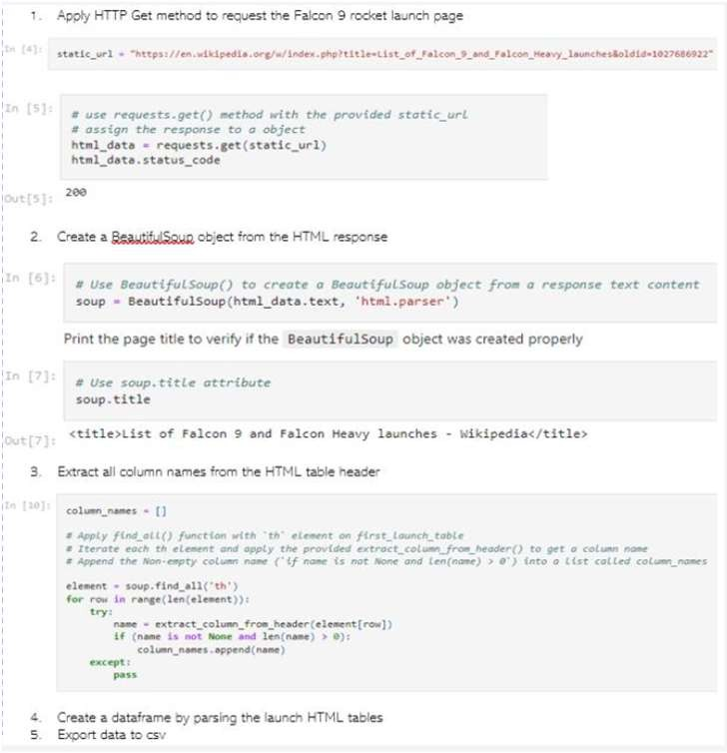
Data Collection
- Scraping
We applied web scrapping to webscrap Falcon 9 launch records with Beautiful Soup
We parsed the table and converted it into a pandas data frame.
The link to the notebook is
https://github.com/ellachronaki/ibm-projects
9

Slide 10
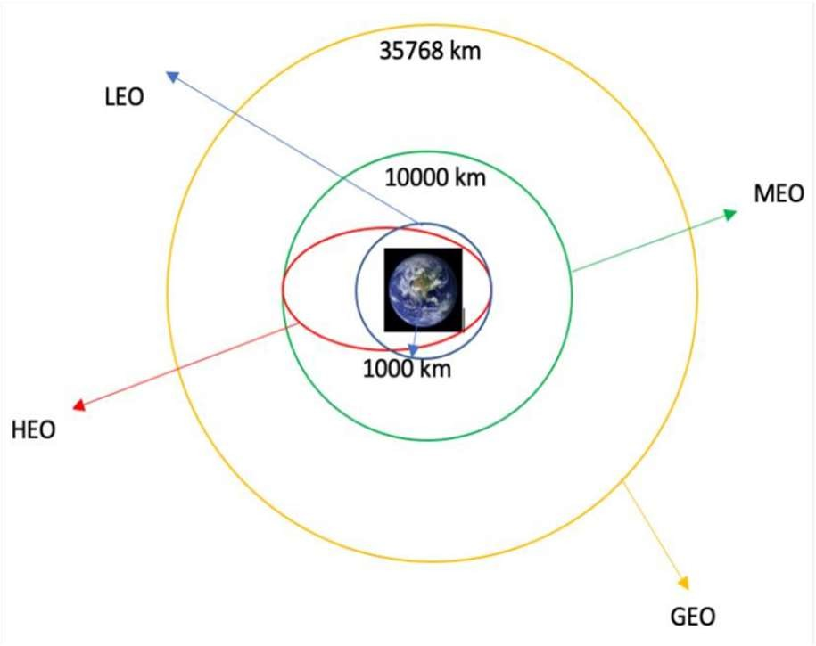






Data Wrangling
WE PERFORMED EXPLORATORY DATA ANALYSIS AND DETERMINED THE TRAINING LABELS.
WE CALCULATED THE NUMBER OF LAUNCHES AT
EACH SITE, AND THE NUMBER AND OCCURRENCE OF EACH ORBITS
WE CREATED LANDING OUTCOME LABEL FROM OUTCOME COLUMN AND EXPORTED THE RESULTS TO
CSV.
THE LINK TO THE NOTEBOOK IS
HTTPS://GITHUB.COM/GAU KARNA/FINAL-PROJECT- APPLIED-DATA-SCIENCE- CAPSTONE/BLOB/MAIN/LAB
YNB.
S-JUPYTER-SPACEX-
DATA%20W¹R⁰ANGLING.IPYN B

Slide 11

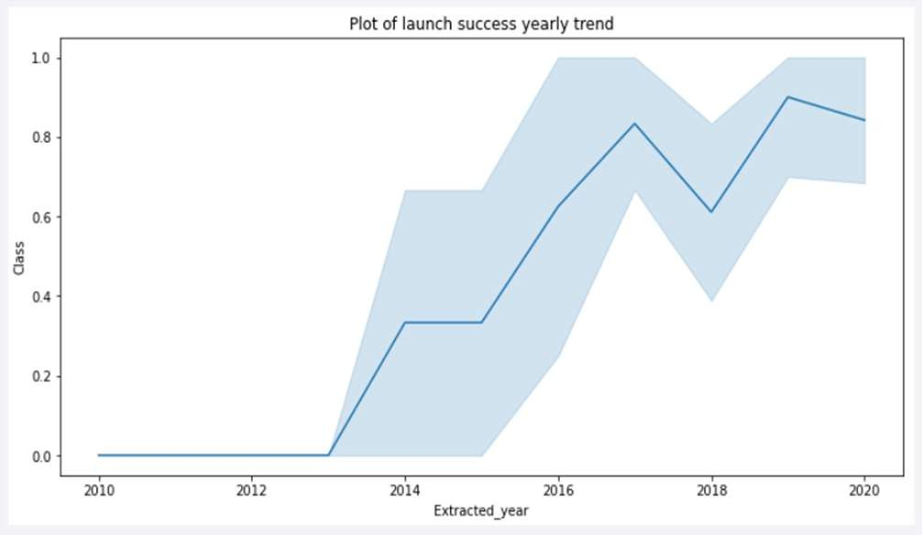
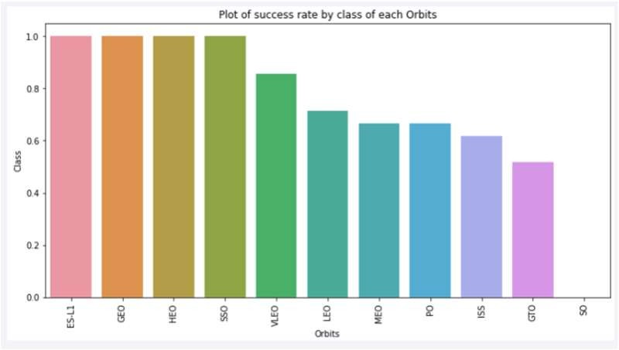
EDA with Data Visualization
We explored the data by visualizing the relationship between flight number and launch Site, payload and launch site, success rate of each orbit type, flight number and orbit type, the launch success yearly trend.
The link to the notebook is
https://github.com/Gaukarna/Final-Project-Applied- Data-Science-Capstone/blob11/main/jupyter-labs-eda- dataviz.ipynb.jupyterlite.ipynb

Slide 12
EDA with SQL
We loaded the SpaceX dataset into a PostgreSQL database without leaving
the jupyter notebook.
We applied EDA with SQL to get insight from
the data. We wrote
queries to
find out for instance:
- The names of unique launch sites in the space mission.
- The total payload mass carried by boosters launched by NASA (CRS)
- The average payload mass carried by booster version F9 v1.1
- The total number of successful and failure mission outcomes
- The failed landing outcomes in drone ship, their booster version and launch site names.
The link to the notebook is https://github.com/Gaukarna/Fin
al-Project-Applied-Data-Science- Capstone/blob/main/jupyter-labs- eda-sql-coursera_sqllite.ipynb

Slide 13
Build an Interactive Map with Folium
We marked all launch sites, and added map objects such as markers, circles, lines to
mark the success or failure of launches for each site on the folium map.
• We assigned the feature launch outcomes (failure or success) to class 0 and 1.i.e., 0
for failure, and 1 for success.
• Using the color-labeled marker clusters, we identified which launch sites have
relatively high success rate.
• We calculated the distances between a launch site to its proximities. We answered
some question for instance:
- Are launch sites near railways, highways and coastlines.
- Do launch sites keep certain distance away from cities.

Slide 14
Build a Dashboard with Plotly Dash
We built an interactive dashboard with Plotly dash
We plotted pie charts showing the total launches by a certain sites
We plotted scatter graph showing the relationship with Outcome and Payload
Mass (Kg) for the different booster version.
The link to the notebook is https://github.com/ellachronaki/ibm-projects

Slide 15
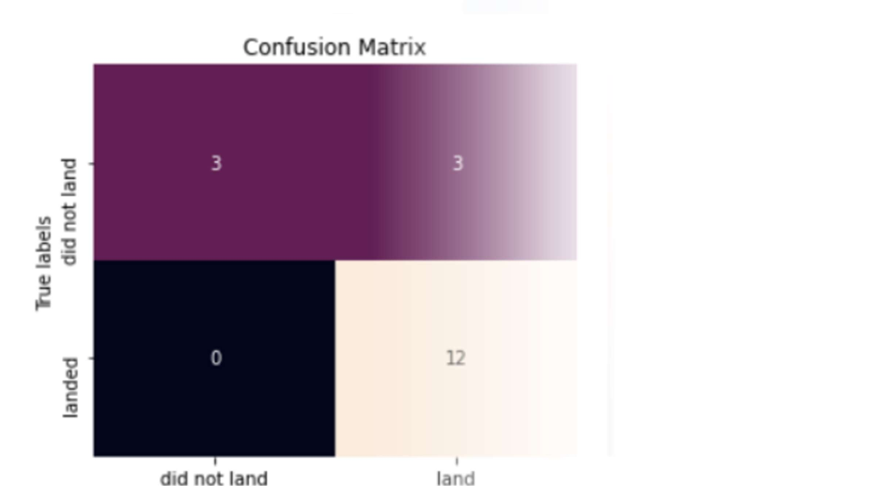
Predictive Analysis (Classification)
We loaded the data using numpy and pandas, transformed the data, split our data into training and testing.
• We built different machine learning models and tune different hyperparameters using GridSearchCV.
• We used accuracy as the metric for our model, improved the model using
feature engineering and algorithm tuning.
• We found the best performing classification model.
• The link to the notebook is
https://github.com/ellachronaki/ibm-projects

Slide 16
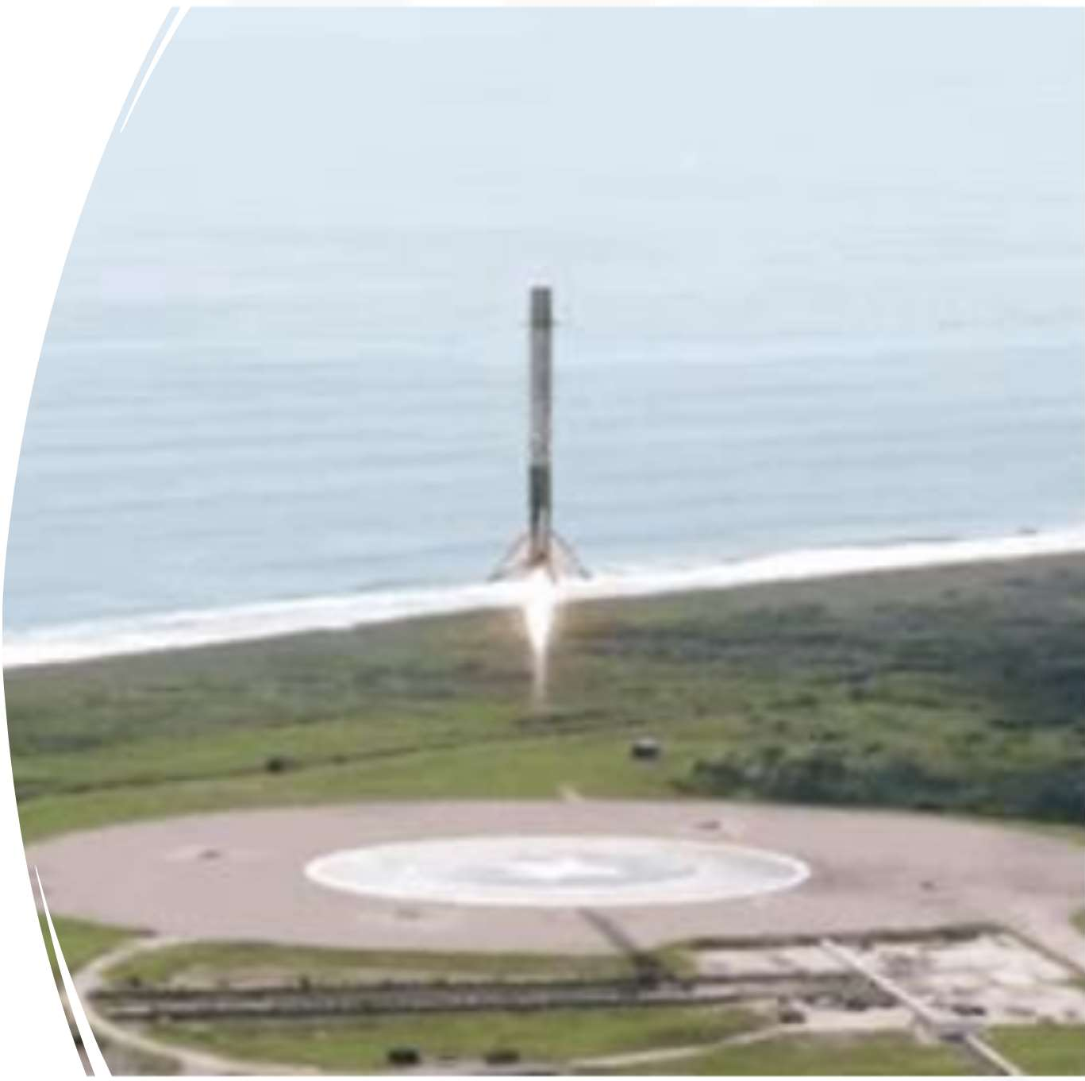
Results
Exploratory data analysis results
Interactive analytics demo in screenshots
Predictive analysis results

Slide 17

Section 2

Slide 18
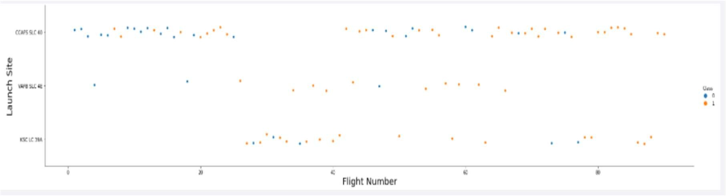
Flight Number vs. Launch Site
• From the plot, we found that the larger the flight amount at a launch site, the greater the success rate at a launch site.

Slide 19
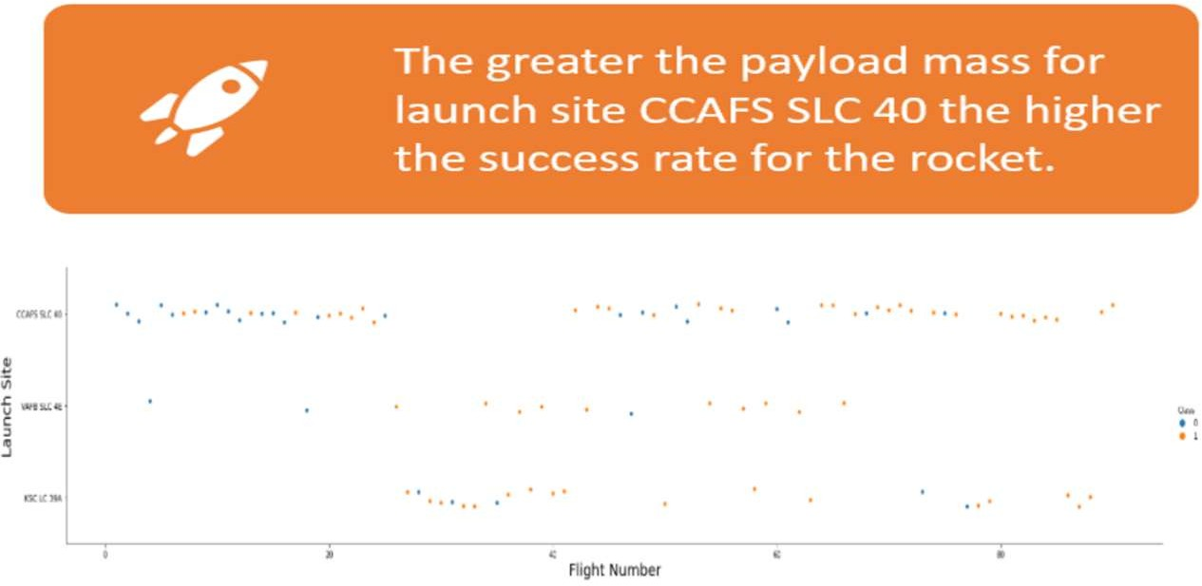
Payload vs. Launch Site

Slide 20

Success Rate vs. Orbit Type
From the plot, we can see that ES-L1, GEO, HEO, SSO, VLEO had the most success rate.
20

Slide 21
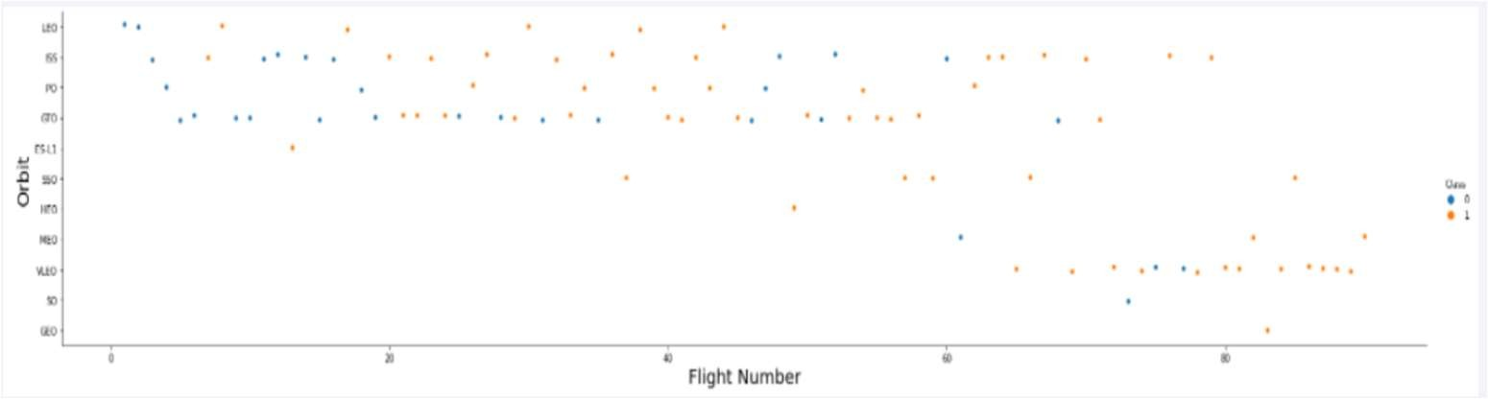
Flight Number vs. Orbit Type
• The plot below shows the Flight Number vs. Orbit type. We observe that in the LEO orbit, success is related to the number of flights whereas in the GTO orbit, there is no relationship between flight number and the orbit.

Slide 22
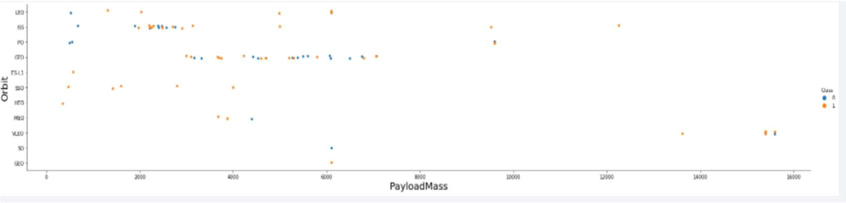
Payload vs. Orbit Type
• We can observe that with heavy payloads, the successful landing are more for PO, LEO and ISS orbits.

Slide 23
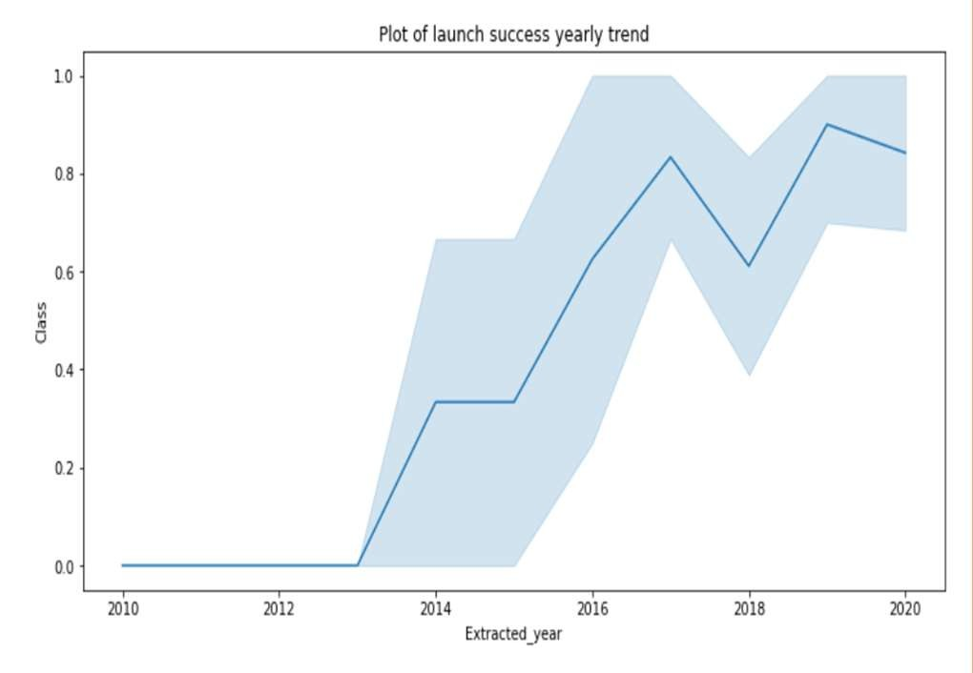
Launch Success Yearly Trend
From the plot, we can observe that success rate since 2013 kept on increasing till 2020.
23

Slide 24
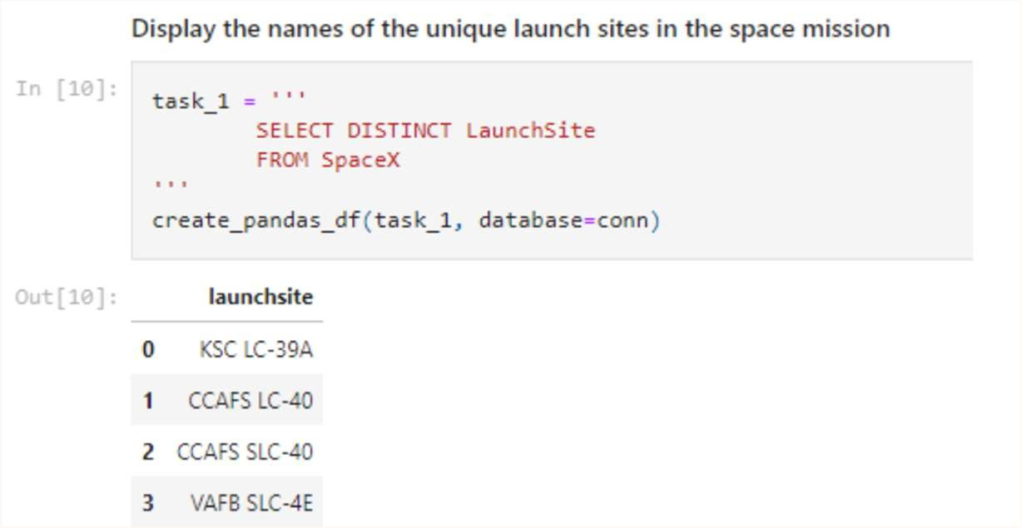
All Launch Site Names
We used the key word DISTINCT to show only unique launch sites from the SpaceX data.
24

Slide 25
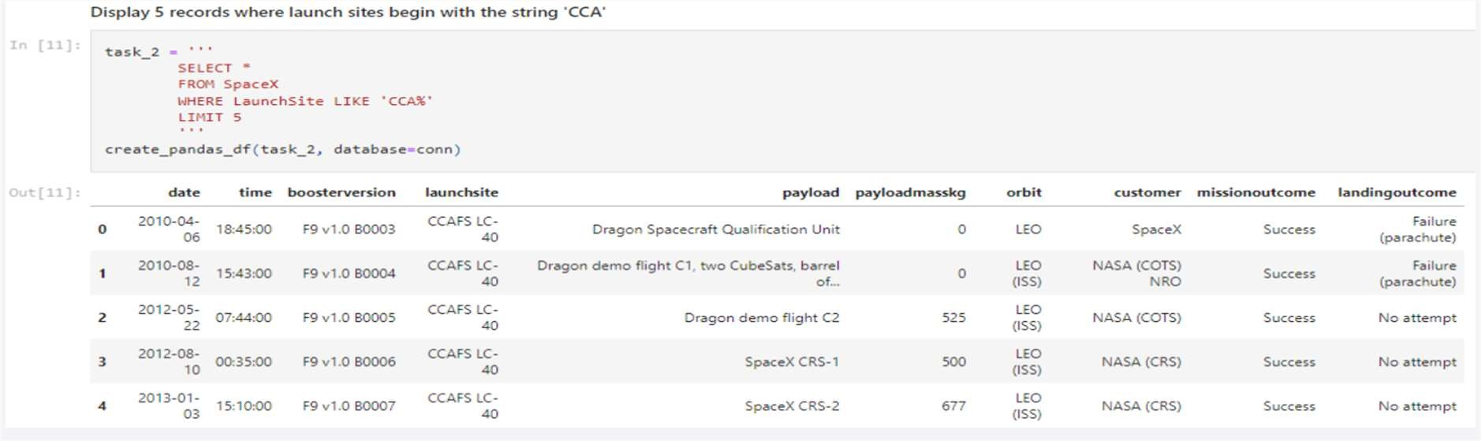
Launch Site Names Begin with 'CCA'
We used the query above to display 5 records where launch sites begin with 'CCA'

Slide 26
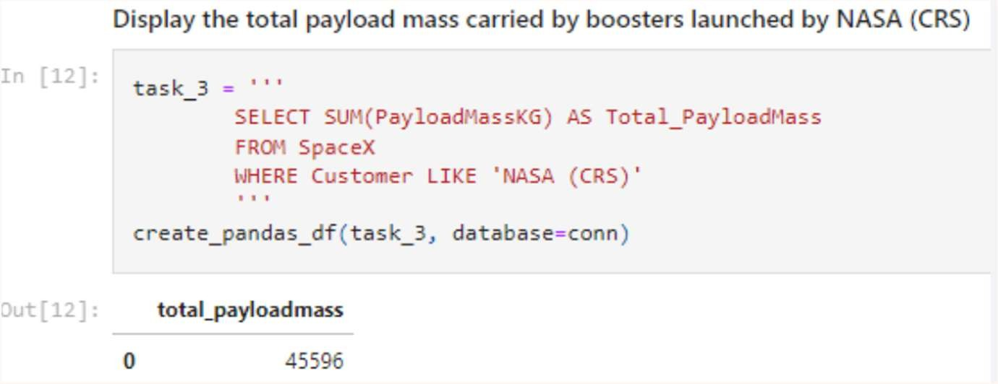
Total Payload Mass
We calculated the total payload carried by boosters from NASA as 45596 using the query below
26

Slide 27
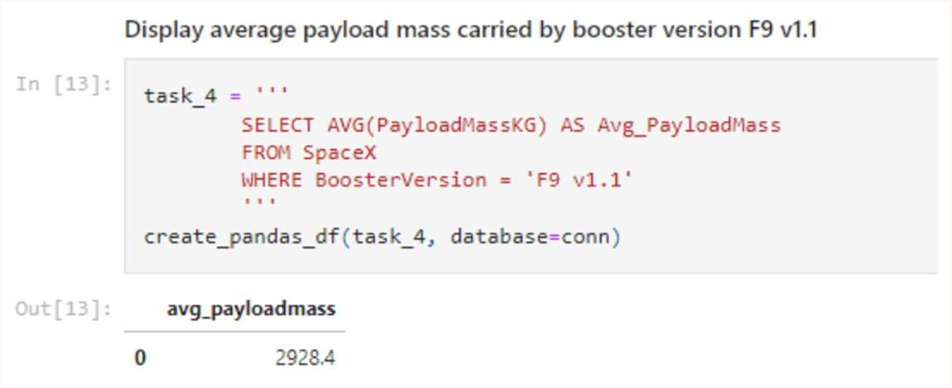
Average Payload Mass by F9 v1.1
We calculated the average payload mass carried by booster version F9
v1.1 as 2928.4
27

Slide 28
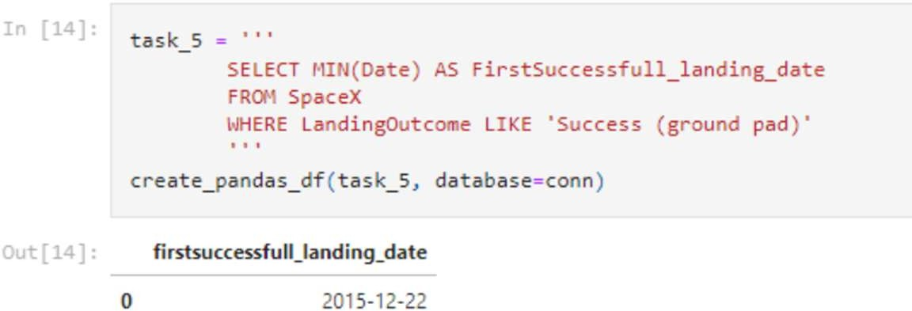
First Successful Ground Landing Date
We observed that the dates of the first successful landing outcome on ground pad was 22nd December 2015

Slide 29
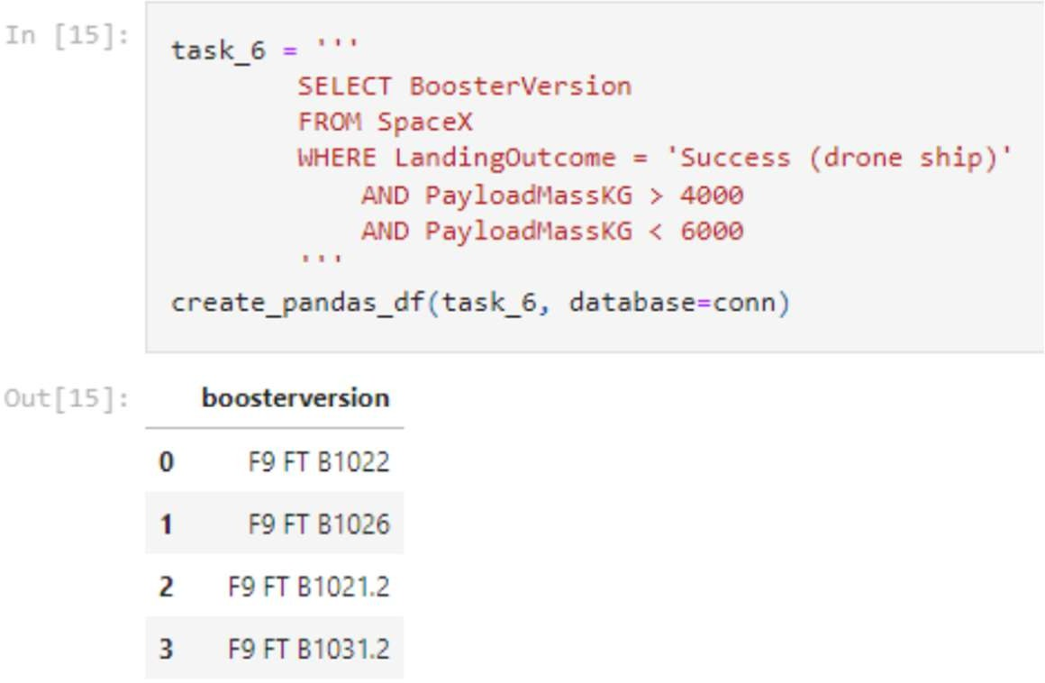
Successful Drone Ship Landing with Payload between 4000 and 6000
We used the WHERE clause to filter for boosters which have successfully landed on drone ship and applied the AND condition to determine successful landing with payload mass greater than 4000 but less than 6000

Slide 30
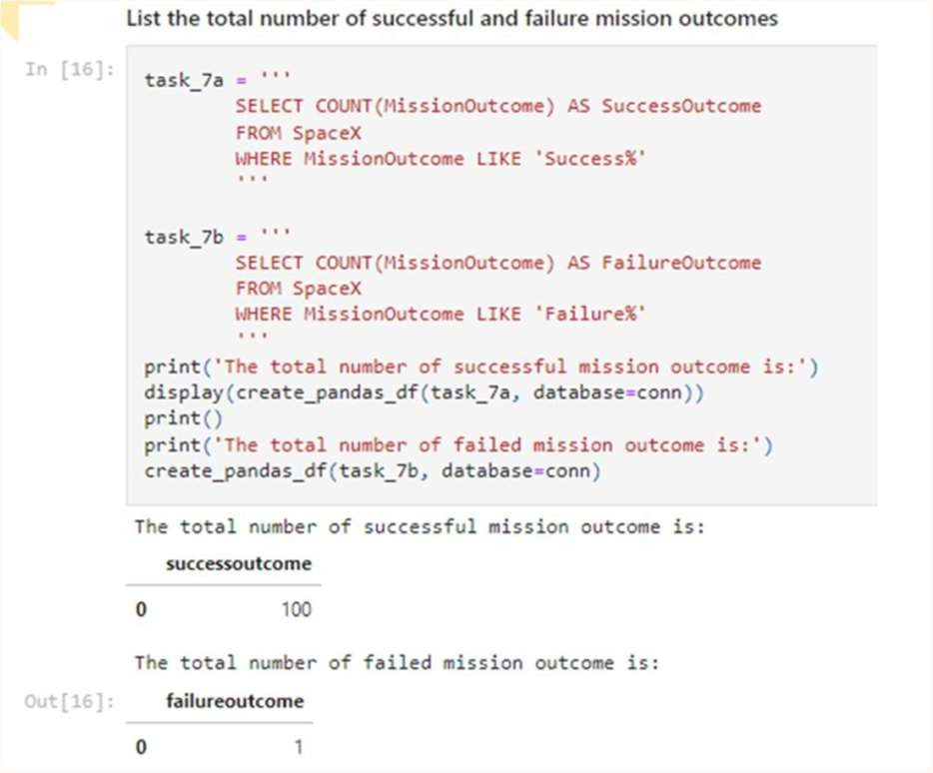
Total Number of Successful and Failure Mission Outcomes
We used wildcard like ‘%’ to filter for WHERE Mission Out come was a success or a failure.
30

Slide 31
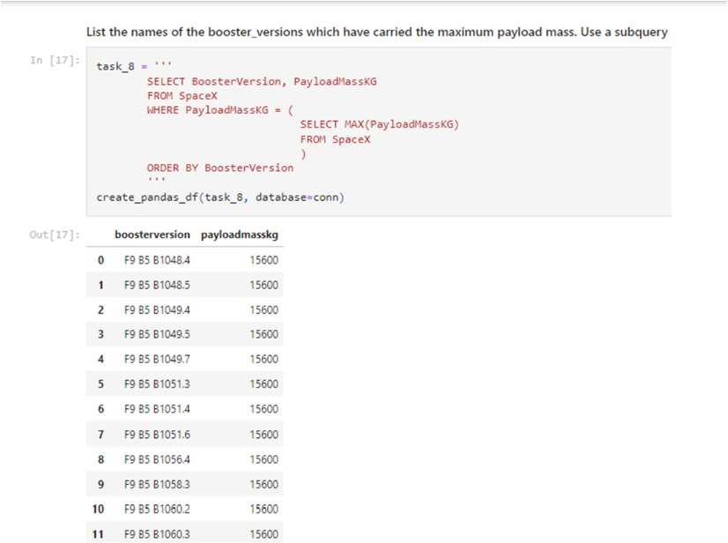
Boosters Carried Maximum Payload
We determined the booster that have carried the maximum payload using a subquery in the WHERE clause and the MAX() function.

Slide 32
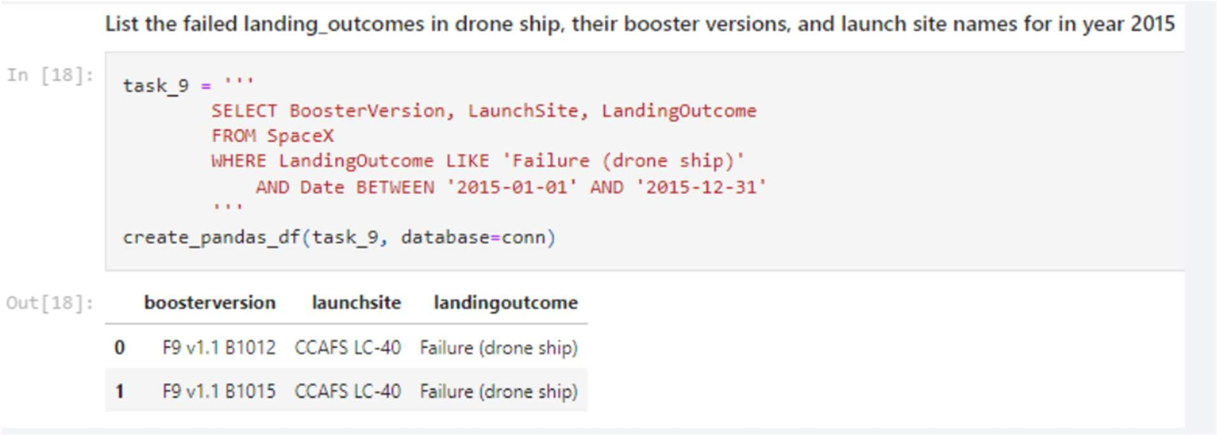
2015 Launch Records
We used a combinations of the WHERE clause, LIKE, AND, and BETWEEN conditions to filter for failed landing outcomes in drone ship, their booster versions, and launch site names for year 2015

Slide 33
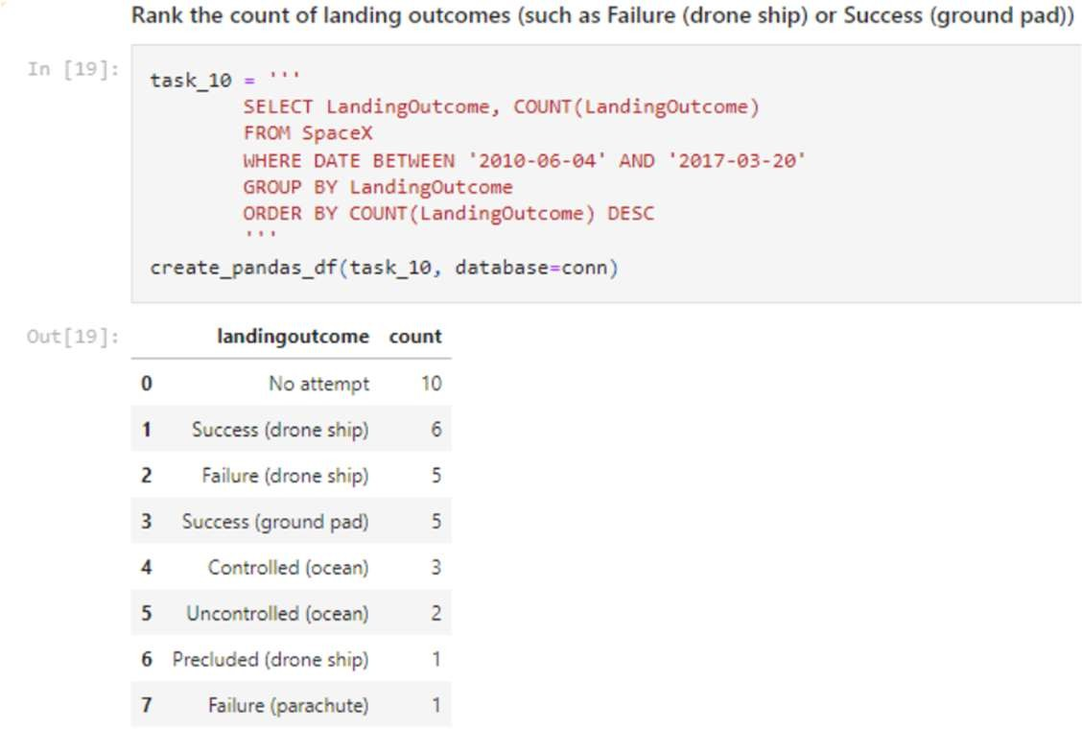
Rank Landing Outcomes Between 2010-06-04 and
2017-03-20
We selected Landing outcomes and the COUNT of landing outcomes from the data and used the WHERE clause to filter for landing outcomes BETWEEN 2010-06-04 to 2010-03-20.
• We applied the GROUP BY clause to group the landing outcomes and the ORDER BY clause to order the grouped landing outcome in descending order.

Slide 34

Section 3

Slide 35
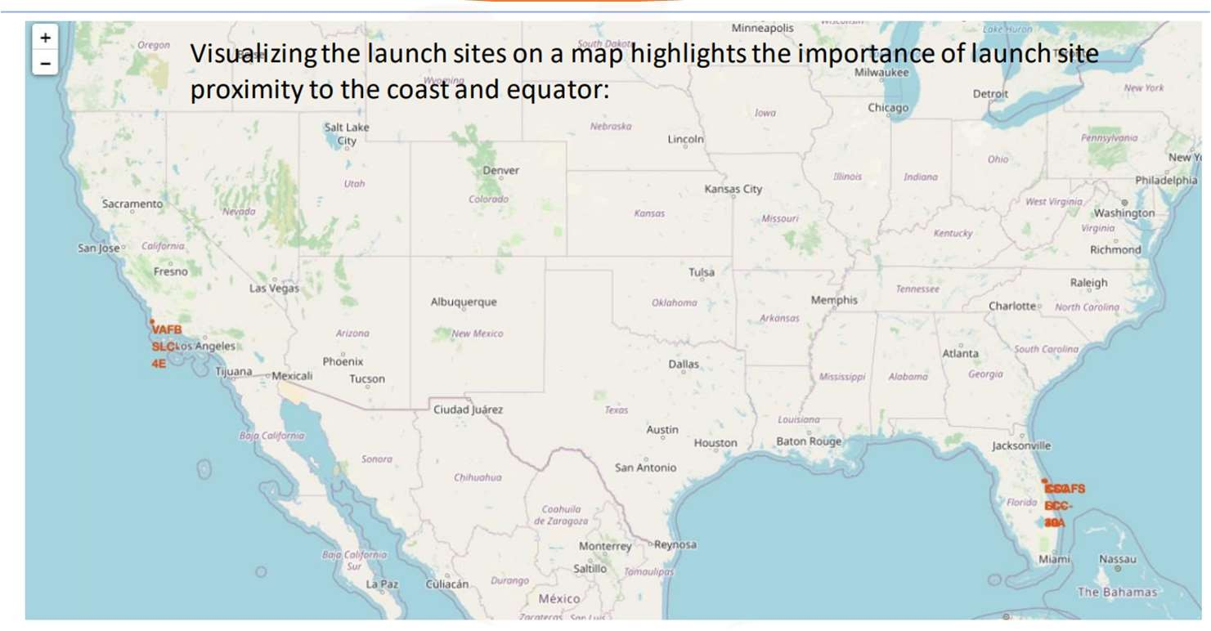
RESULTS LAUNCH SITE LOCATION ANALYSIS:1

Slide 36
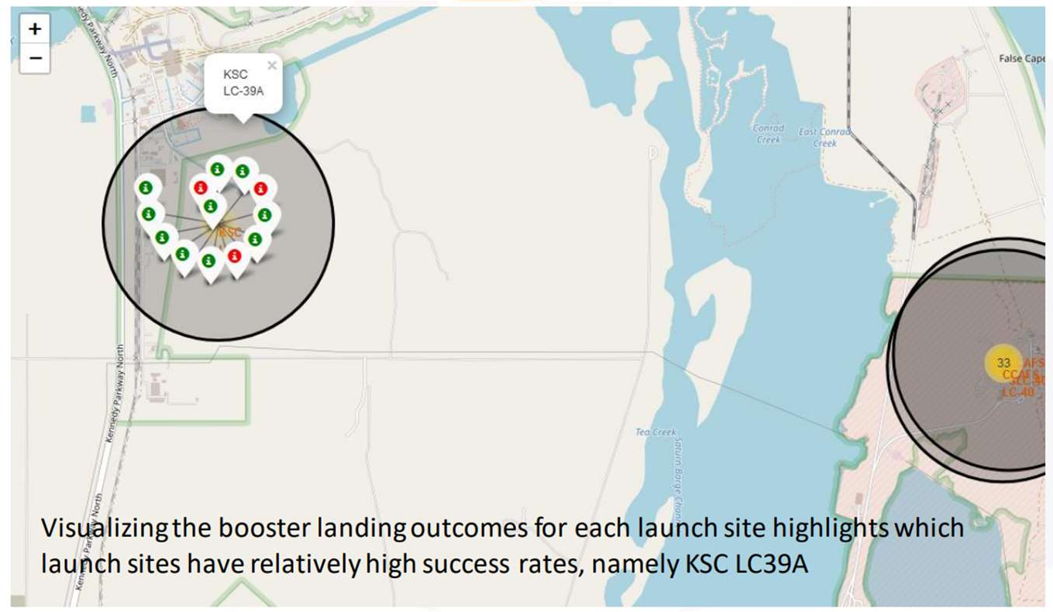
RESULTS LAUNCH SITE LOCATION ANALYSIS:2

Slide 37
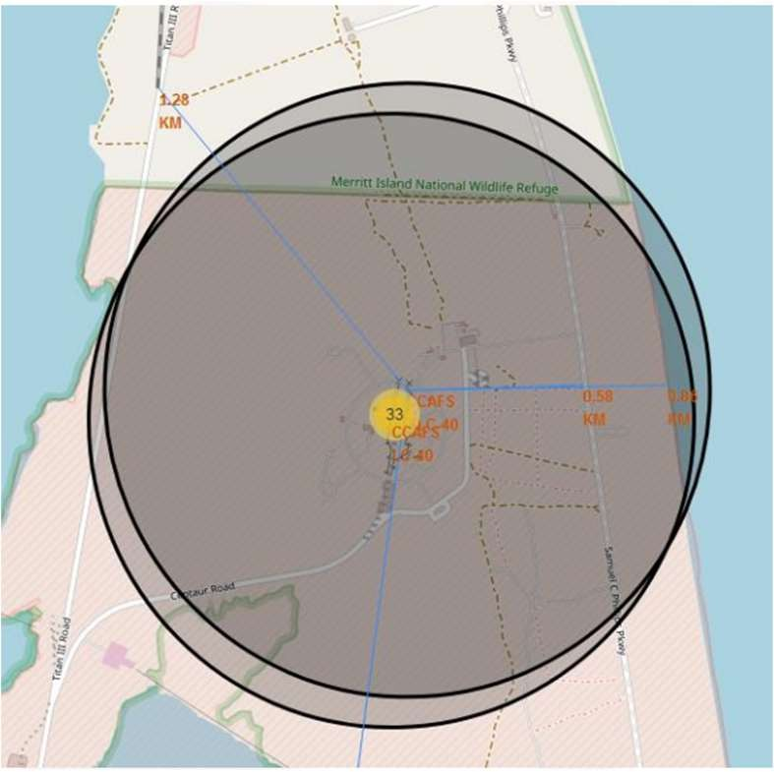
RESULTS LAUNCH SITE LOCATION ANALYSIS: 3
Visualizing the railway, highway, coastline, and city proximities for each launch site
Proximities for CCAFS SLC-40:
• railway: 1.28 km
• transporting heavy cargo
• highway: 0.58 km
• transporting personel and equipment
• coastline: 0.86 km
• optionality to abort launch and
attempt water landing
• minimizing risk from falling debris
• city: 51.43 km
• minimizing danger to population dense
areas.
37

Slide 38

Section 4

Slide 39
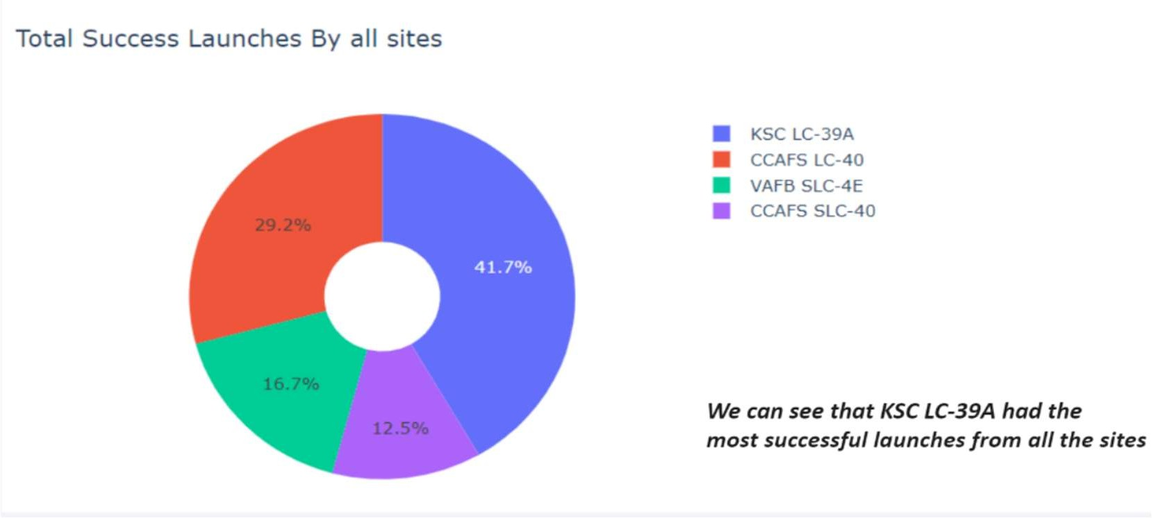
Pie chart showing the success percentage achieved by each launch site1
39

Slide 40
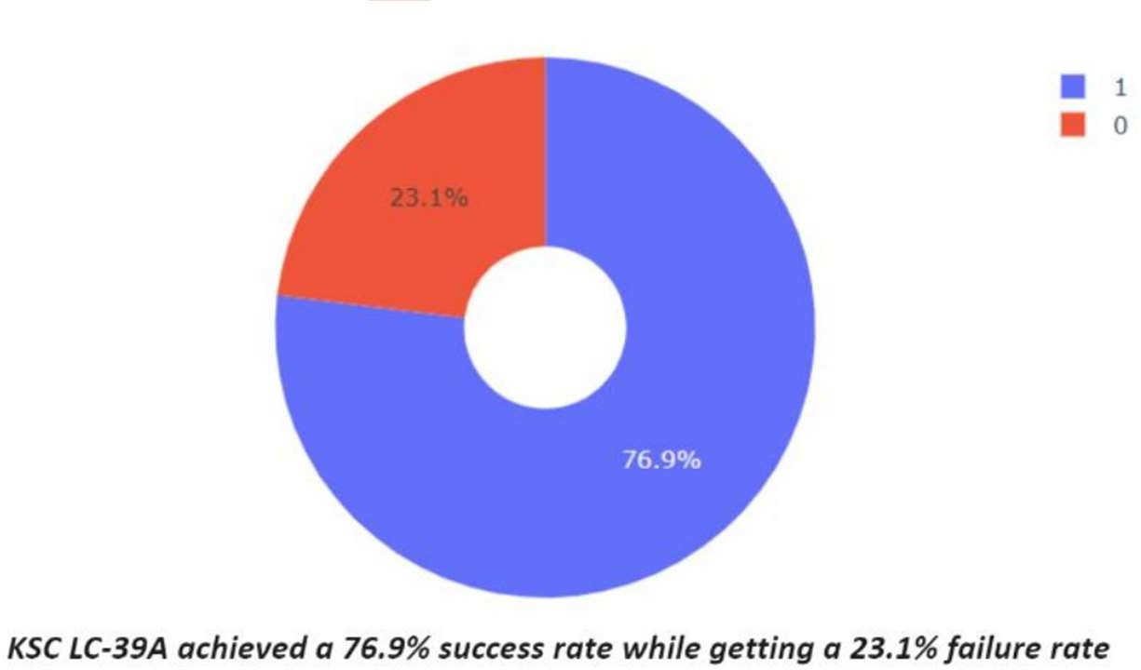
Pie chart showing the Launch site with the highest launch success ratio2
40

Slide 41
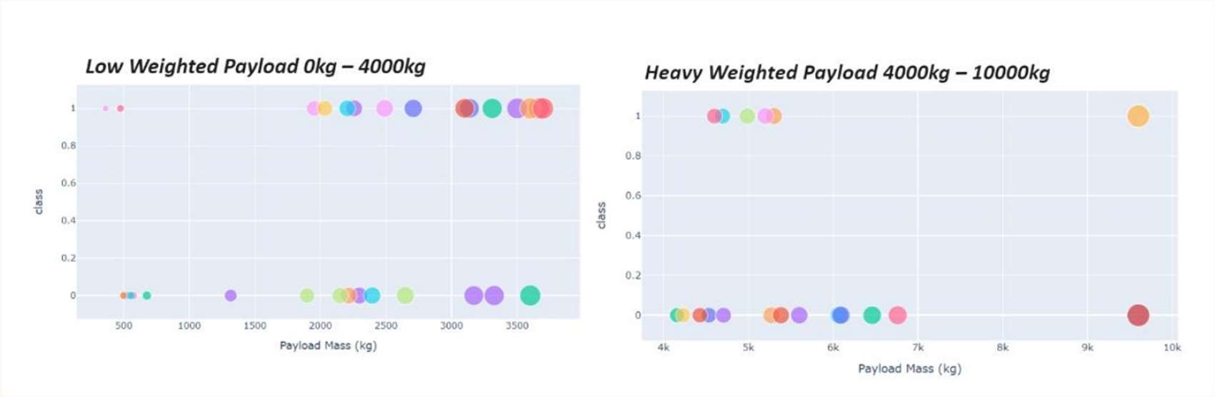
Scatter plot of Payload vs Launch Outcome for all sites, with different payload selected in the range slider
We can see the success rate of low weighted payloads is higher than the heavy loaded
payloads
41

Slide 42

Section 5

Slide 43
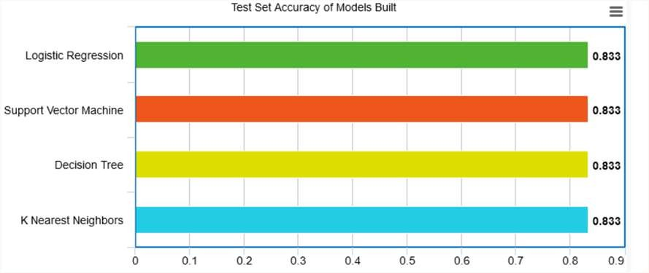
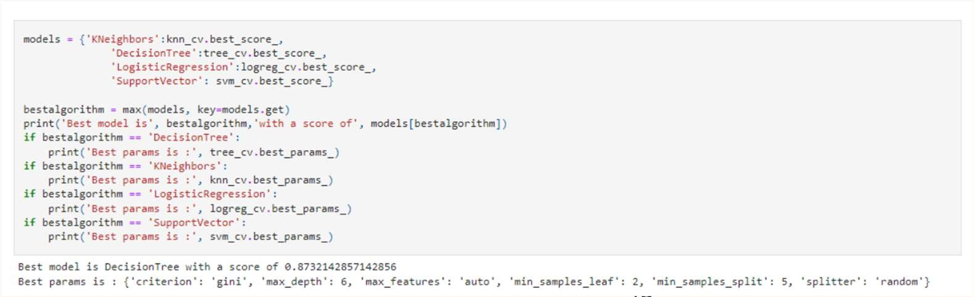
Results: Classification Accuracy
43
The Decision Tree classifier is the model with the highest classification accuracy.

Slide 44


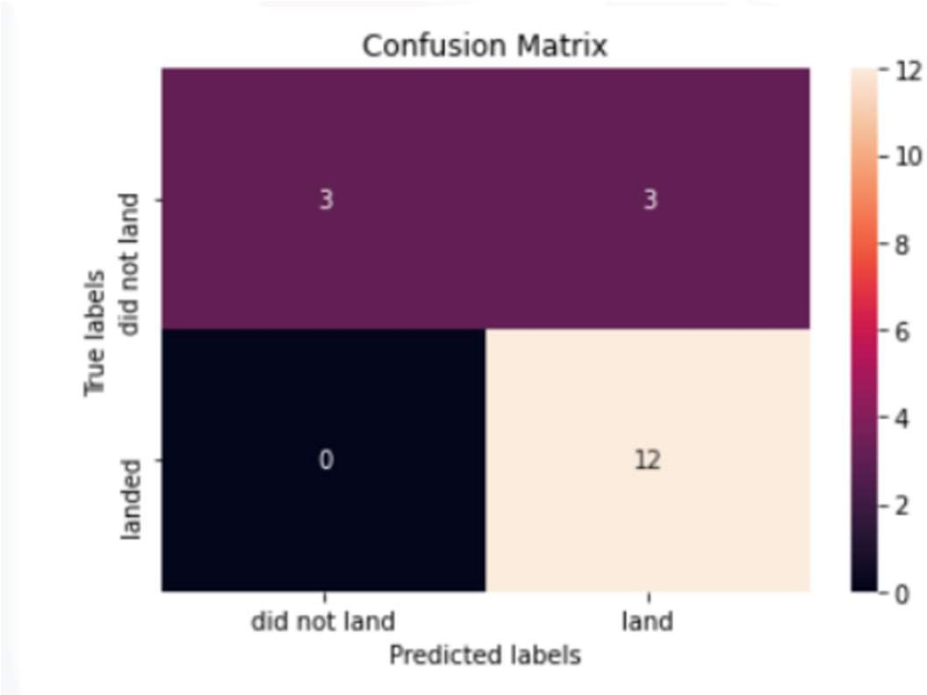
Results: Confusion Matrix
• The confusion matrices of the best performing models (4-way- tie) are the same
• The major problem is false positives as evidenced by the models incorrectly predicting the 1st stage booster to land in 3 out of 18 samples in the test set

Slide 45






Conclusions
The larger the flight amount at a launch site, the greater the success rate at a launch site.
Launch success rate started to increase in 2013 till 2020.
We can conclude that:
Orbits ES-L1, GEO, HEO,
SSO, VLEO had the most success rate.
KSC LC-39A had the most successful launches of any sites.
The Decision tree classifier is the best machine learning algorithm for this task.

Slide 46









Appendix
1
2
3
4
5
6
7
8
9
Notebooks to recreate dataset, analysis, and models:
https://github.com/ellachronaki/ibm-projects/blob/main/jupyter-labs-spacex-data-collection-api%20(1).ipynb
https://github.com/ellachronaki/ibm-projects/blob/main/jupyter-labs-webscraping%20(1).ipynb
https://github.com/ellachronaki/ibm-projects/blob/main/labs-jupyter-spacex-Data%20wrangling.ipynb
https://github.com/ellachronaki/ibm-projects/blob/main/jupyter-labs-eda-sql-coursera_sqllite.ipynb
https://github.com/ellachronaki/ibm-projects/blob/main/jupyter-labs-eda-dataviz.ipynb.jupyterlite.ipynb
https://github.com/ellachronaki/ibm-projects/blob/main/jupyter-labs-eda-dataviz.ipynb.jupyterlite.ipynb
https://github.com/ellachronaki/ibm-projects/blob/main/spacex_dash_app.py
https://github.com/ellachronaki/ibm-projects/blob/main/spacex_dash_app.py

Slide 47


